Slide 1


Employees Info
Abdullah m. moraished

Slide 2

Overview
This project about EDA with all steps.
This is general date for HR information.
I do some data analysis.
The Dataset has 54000 rows and 11 columns.

Slide 3
Data Description
The Dataset has 11 columns and each column has several Properties:
Column’s string type:
Department, region , education , gender , recruitment channel.
Column's integer type:
Employee id, age , previous year rating , length of service , KPIs , is promoted.

Slide 4

Questions and problems
How Mach the percentage male vs female has been promoted ?
Who is the higher performance last year male vs female ?
Which department using higher number of employ ?
What is the average years of experience for promotion ?
If KPIs is high, does it affect the promotion ?
What is the average age of the employees ?
Number of men and women with a scientific qualification ?

Slide 5
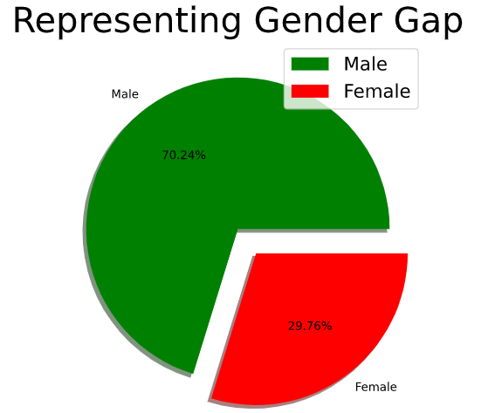
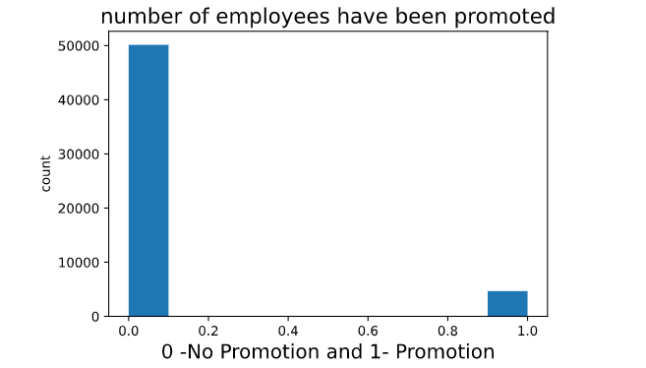
Solutions and Answers
How Mach the percentage male vs female has been promoted ?

Slide 6
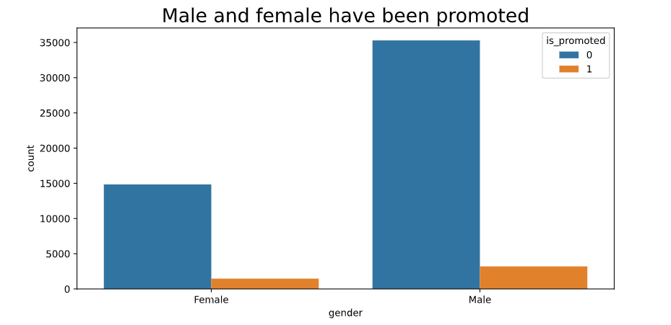
conclusion
In my opinion :
They have an unequal Percentage because males are the largest number of employees

Slide 7
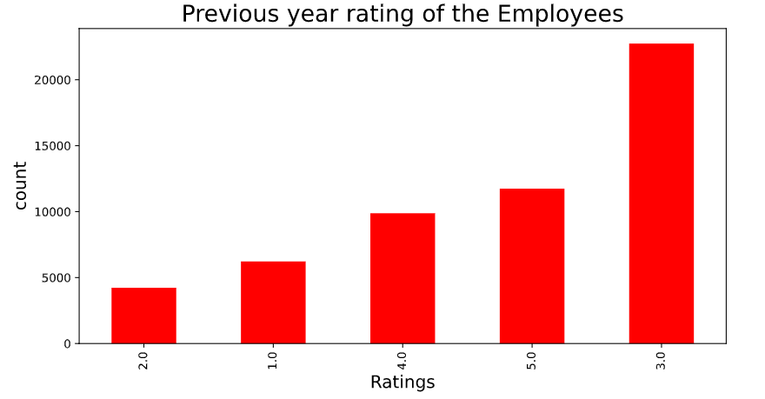
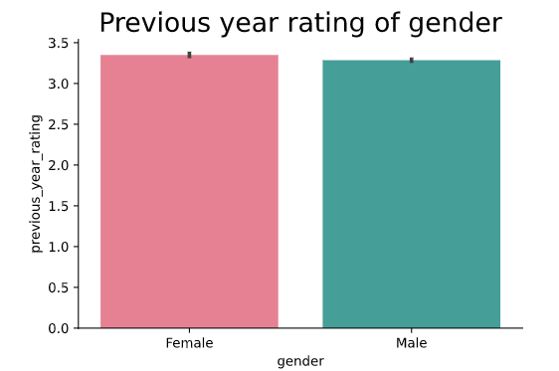
Who is the higher performance last year male vs female ?
Male and female have almost the same rating in last year.
Male rating average 8.3% female rating average 8.9%

Slide 8
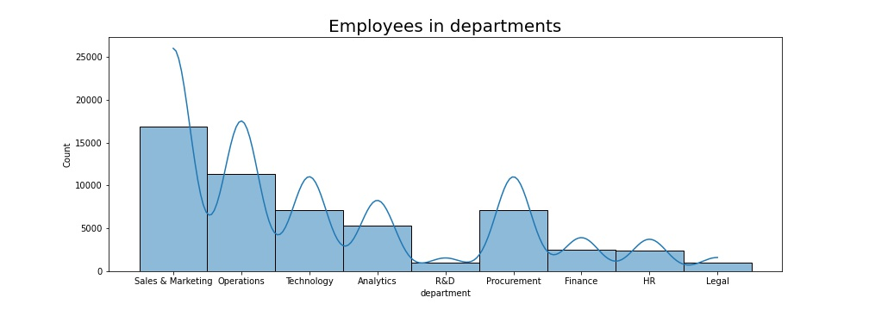
Which department using higher number of employ ?
S&M It is the most employable .
R&D should have more employees.

Slide 9
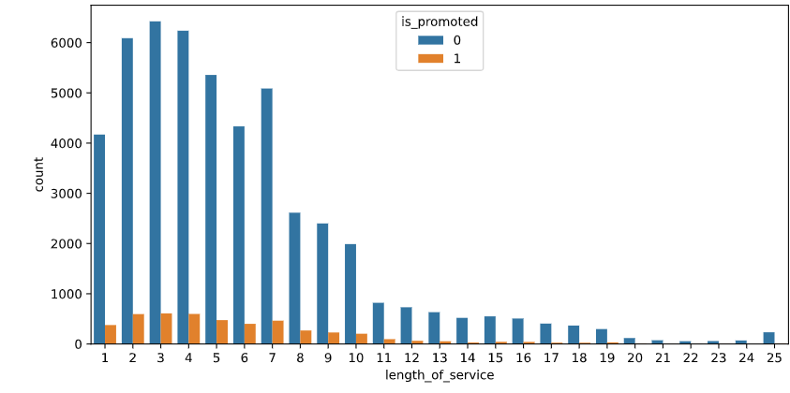
What is the average years of experience for promotion ?
First 4 years is the highest promotions.
But this years have a lot of employees.

Slide 10
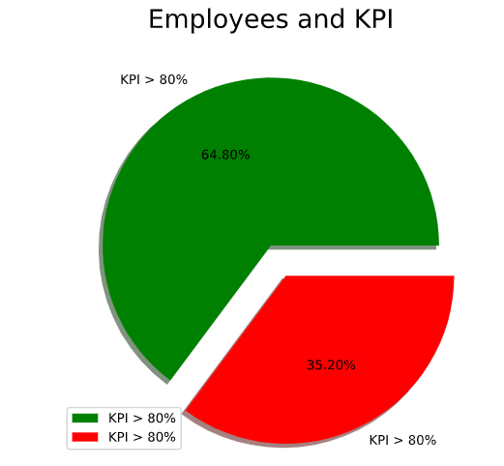
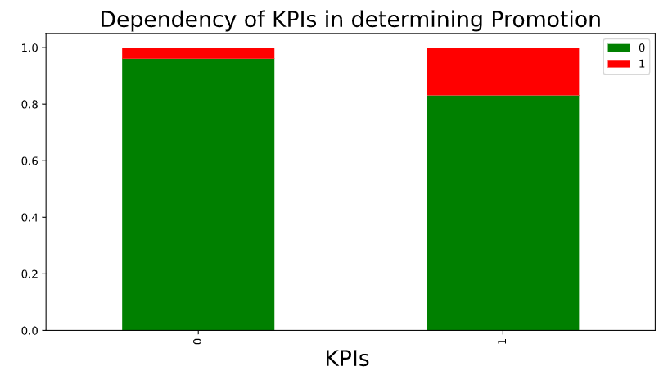
If KPIs is high, does it affect the promotion ?
KPIs is high.
KPIs is important reason for promotion.

Slide 11
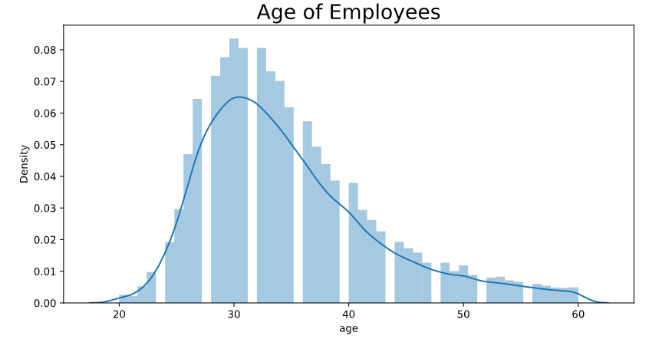
What is the average age of the employees ?
You can see here a mistake
This company should employ more in age 25 and less and keep more employees in age 45 and more.

Slide 12

Tools
Pandas
Marplotlib
Seaborn
Jupyter Notebook
MS Word
MS PowerP

Slide 13

Thanks for your time
- Abdullah Moraished

